Slide 1
Deeper in List and String

Slide 2


Example 1

Slide 3


Example 2

Slide 4
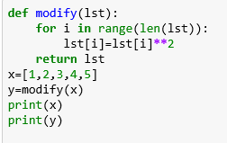

Example 3

Slide 5
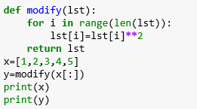

Example 4

Slide 6
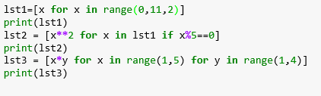

Example 5 – List Comprehension

Slide 7
insert, delete, update one character
str = ‘hello friends’
str.insert(1,’a’) # error: 'str' object has no attribute 'insert’
del str[1] # error: object doesn't support item deletion
Str.remove(‘h’) # error: 'str' object has no attribute 'remove'

Slide 8
How to do ?
str = "hello dear students";
lst=list(str)
del lst[1]
lst.insert(1,'a')
lst.remove('h')
str="".join(lst)
print(str)

Slide 9

Example 7
Write a program to swap the case. i.e. Upper case to lower and lower to upper
Input- Hello Friends 123
Output – hELLO fRIENDS 123

Slide 10
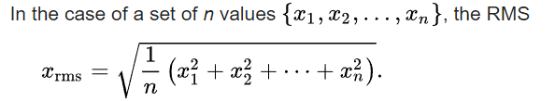
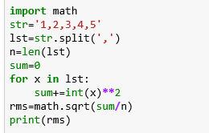
Example 8
Write a program to determine root mean square of the given comma separated values.
Input- 1,2,3,4,5
Output- 3.31

Slide 11
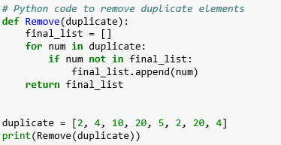
Example 9
Remove the duplicate elements from the list
Input : [2, 4, 10, 20, 5, 2, 20, 4]
Output : [2, 4, 10, 20, 5]

Slide 12
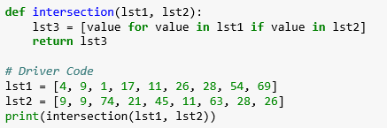
Example 10
Determine intersection between two lists
Input :
lst1 = [15, 9, 10, 56, 23, 78, 5, 4, 9]
lst2 = [9, 4, 5, 36, 47, 26, 10, 45, 87]
Output :
[9, 10, 4, 5]

